Slide 1
Internship Project
Name : Abhiyank Goyal
Program : T.Y. B-Tech, CSE, trimester - IX
PRN No. : 1032170652
Company : Simption Tech. Pvt. Ltd.
Project Title : Student Registration
(School Software System)

Slide 2
Objectives
To Design online Student Registration System for School/College Software System.
It includes a sign-up form for the registration of the user.
It consists of login form.
It includes a form that allows admin to enter student details like:
Registration No.(which is automatically generated to remove duplicacy)
Student new/old
Class
Student name

Slide 3
Objectives
Gender
Date of admission
Bus service
Registration fees
Student’s address
Student photo
Student’s parent details
And other important details

Slide 4
Objectives
On click of the submit button the page should be validated and after successful validation the data must be saved in the database.
The admin should be directed to the page where he can view the list of all the students registered
Each student should have an option to modify and delete the details
Each student is also given an option to make an admission.

Slide 5
Objectives
On click of which a separate page must open showing the student details and an option to upload various identification documents.
Once the documents are uploaded the user should be able to save the documents to the database and directed to the page where the list of all the students admitted is displayed.
Also there should be an option to print the receipt of the student’s admission.

Slide 6
Task Completed till date
Gathered project requirements
Details necessary for registering a student
Frameworks and technologies to be used
Designed a Sign-up and login page with the help of html5 and CSS.
Validated the Sign-up and login form with the help of JavaScript.
Designed a Registration Form with the help of html5 and CSS.

Slide 7
Task Completed till date
Stored the Student details in the Local Storage of the browser with the help of JavaScript.
Designed the students list page which consists a list of all the students registered and options to modify their details and make the admission and print receipt and delete the record the of the student.
Implemented functionality to allow user to modify, or make the admission or delete the registered student.

Slide 8
Task Completed till date
Designed and styled a page to upload various documents required for the admission.
Stored the uploaded documents in the local storage of the same student through JavaScript.
Designed and styled a page of admitted students which shows the list of all the students admitted. It has options to modify, print and delete the record of the student.
Below are the screenshots of the work:

Slide 9
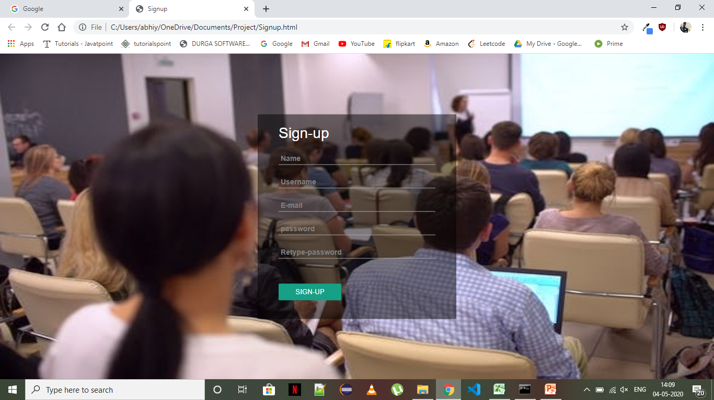
Sign-Up Page

Slide 10
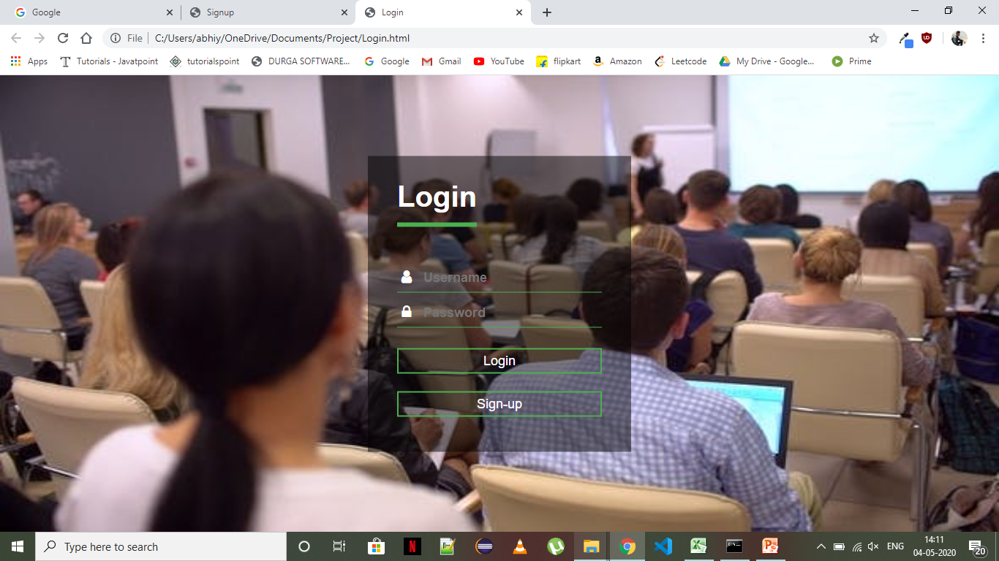
Login Page

Slide 11
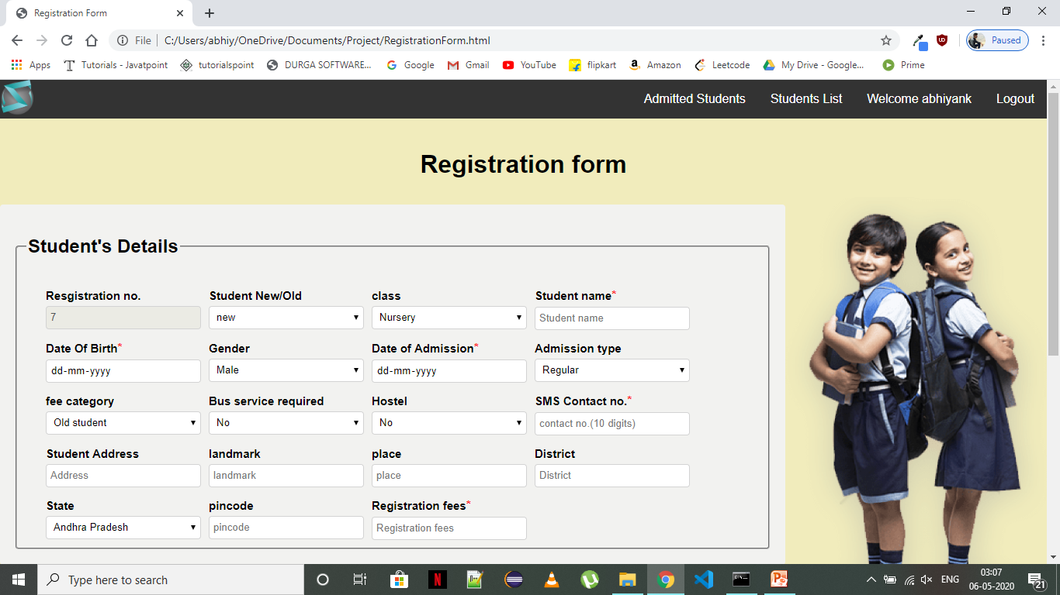
Registration Form

Slide 12
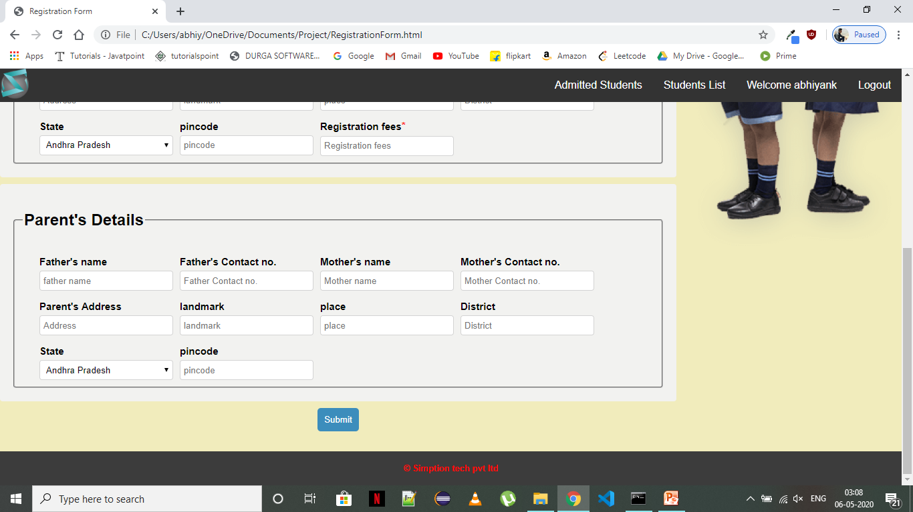

Slide 13
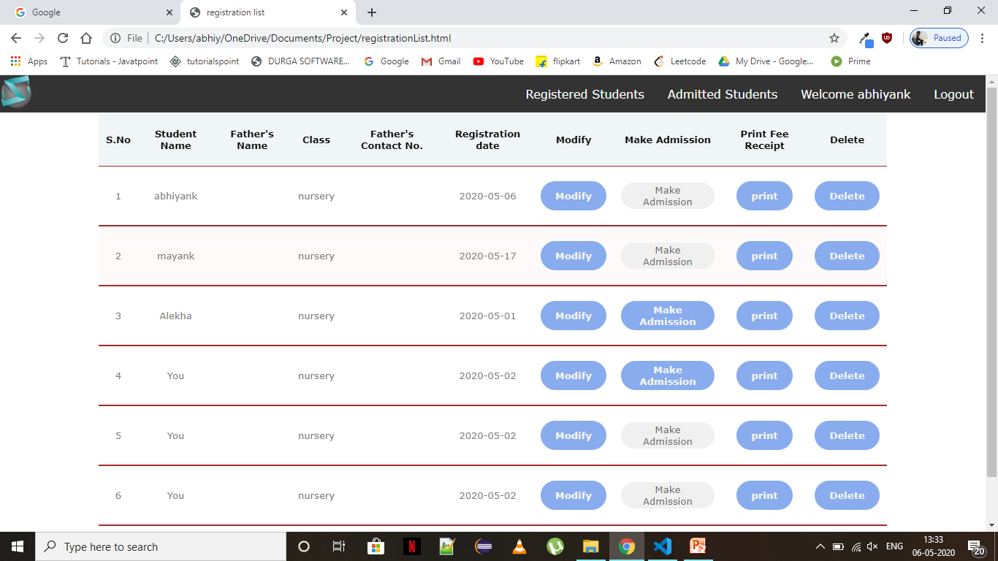
Registered Students list page

Slide 14

Update Student Details page

Slide 15
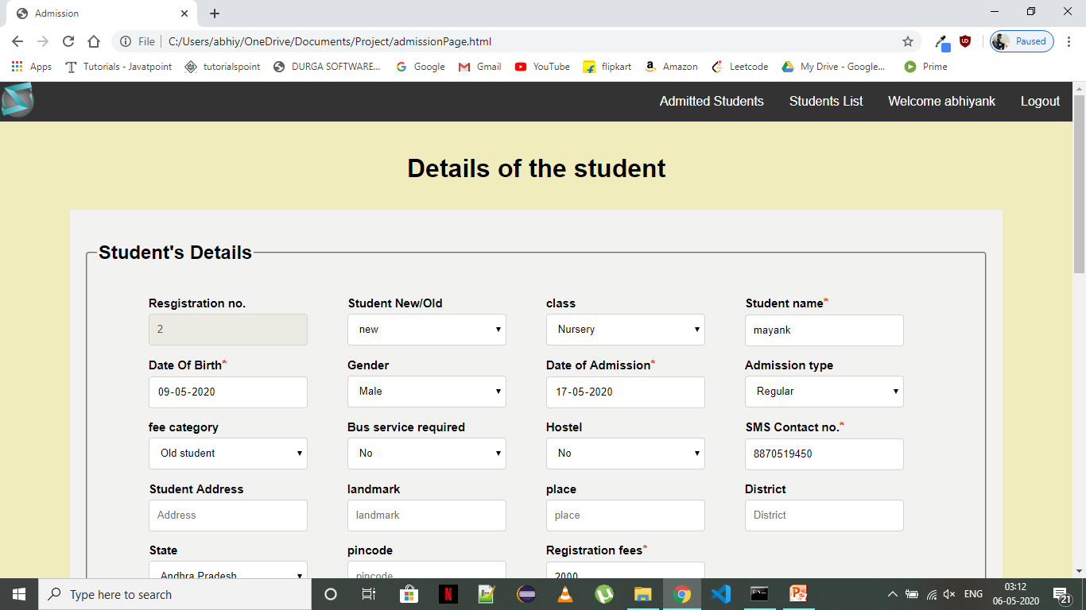
Documents upload page

Slide 16
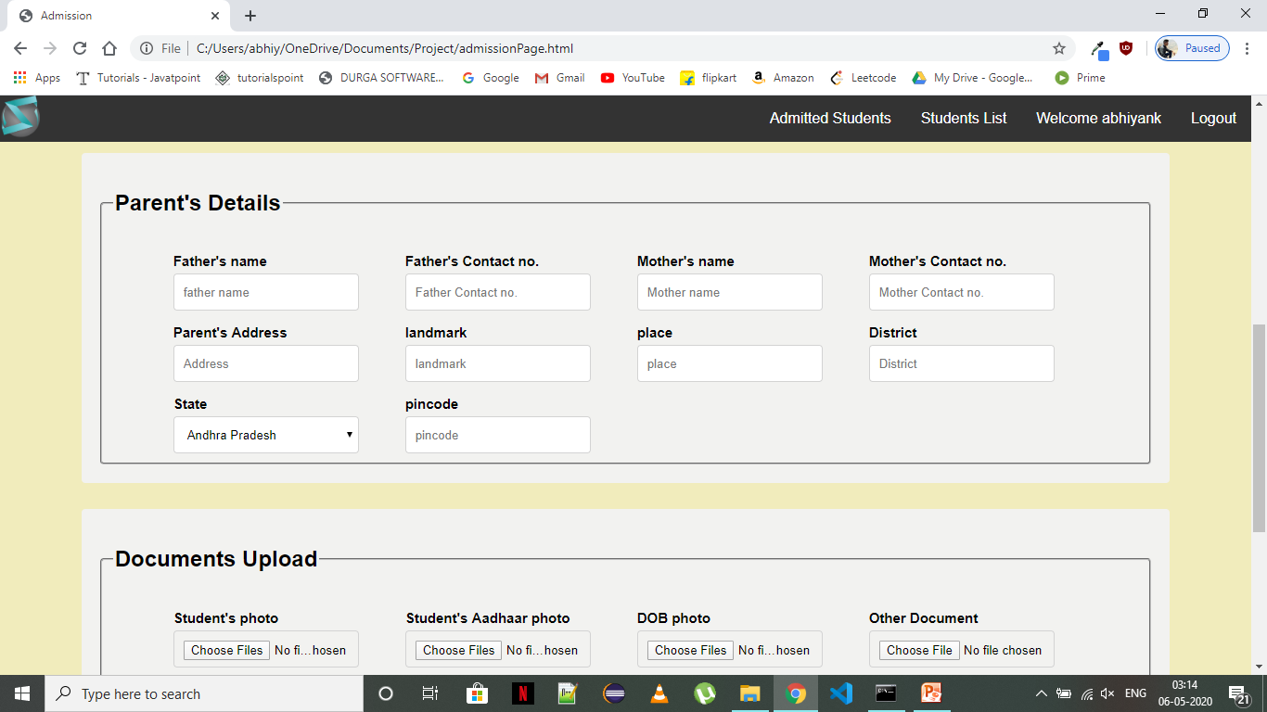

Slide 17
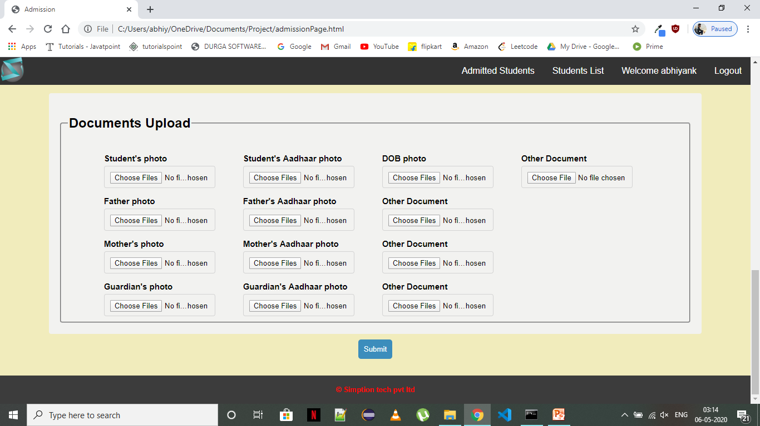

Slide 18
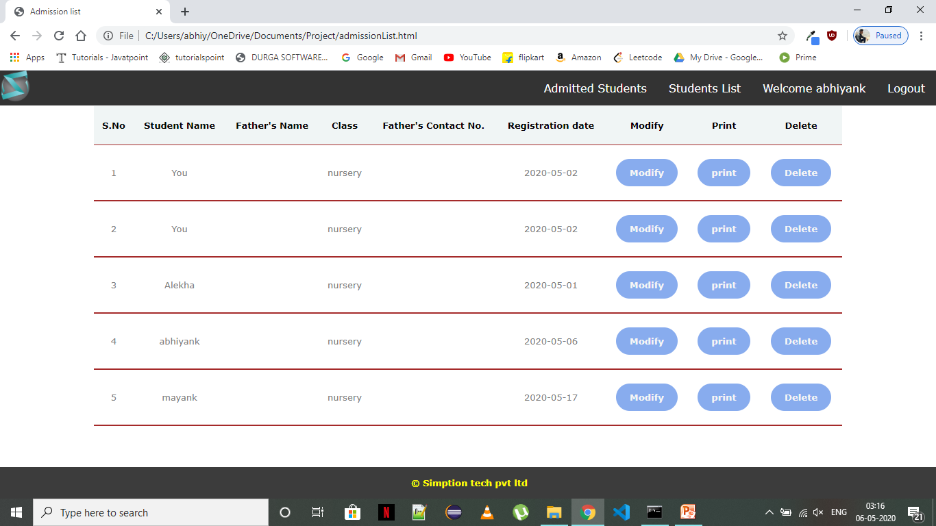
Admitted Students page

Slide 19
Key Learning's till date
Understanding of attributes required to register a student or make an admission for him.
Able to use html5 to design structure of a given web application
Using CSS to style the web application
Understanding how CSS helps in creating responsive web design.

Slide 20
Key Learning's till date
Training on JavaScript.
learned how to describe functionality of the web pages through JavaScript
Learned how to apply form validation using JavaScript.
Learned to use local storage and session storage of the browser to store data and use that data.

Slide 21
Action Plan for the remaining period of time
Will use MYSQL or SQL SERVER for persisiting data of all the students registered
Will be using php to perform crud operations on data.
Will also perform logical transformation of data using php before returning it to java script front end.

